Slide 1

CDL Test System Modernization Project
Presented By:
Brian Brunt
Kansas State CDL Coordinator
Driving Kansas Into the Future

Slide 2
Topics
Objectives
Goals
Overview of Proposed Vehicle Inspection
Overview of Proposed Basic Control Skills
Driving Kansas Into the Future

Slide 3
Objectives
Revise the AAMVA CDL Testing System to more closely align with industry standards and training practices.
Produce a revised test model that will maintain high standards for evaluating whether an entry-level commercial driver has the required technical knowledge and skill to safely operate a CMV.
Improve test administration effectiveness and efficiency.
Driving Kansas Into the Future

Slide 4
Core Project Goals
Safety – Safety of drivers and the general public.
Basic Skills – Ensuring drivers have entry-level skill sets for licensure to enter the industry.
Technology – Create a test model that remains both valid and reliable in a fast-changing technological environment.
Driving Kansas Into the Future

Slide 5
2022 Vehicle Inspection Test
Overview of the 2022 Modernized
Vehicle Inspection Test
Driving Kansas Into the Future

Slide 6
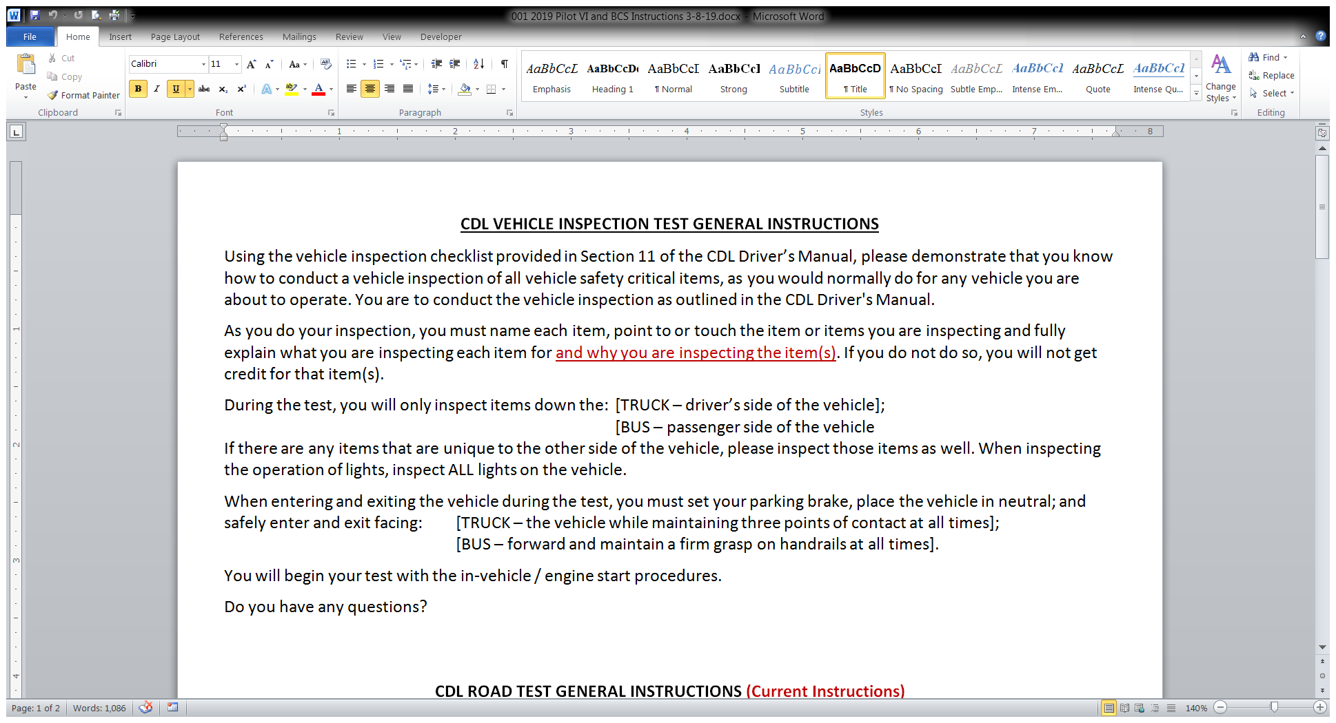
Sample Instructions
Driving Kansas Into the Future

Slide 7
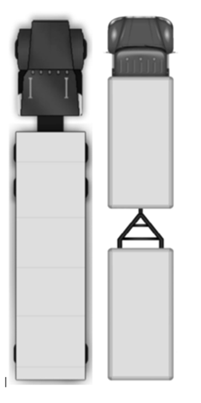
Class A Truck/Tractor & Trailer Checklist
Driving Kansas Into the Future

Slide 8
Class A Truck/Tractor & Trailer Guide
Driving Kansas Into the Future

Slide 9
Class A Truck/Tractor & Trailer Guide
Driving Kansas Into the Future

Slide 10
Class A Truck/Tractor & Trailer Guide
Driving Kansas Into the Future

Slide 11
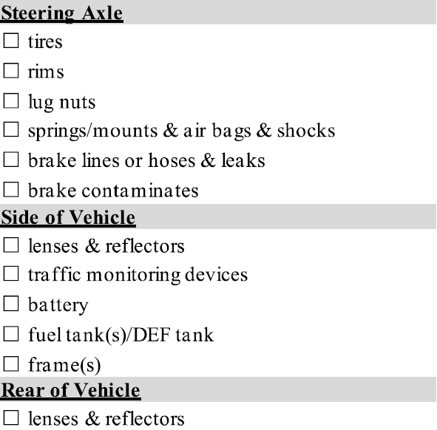
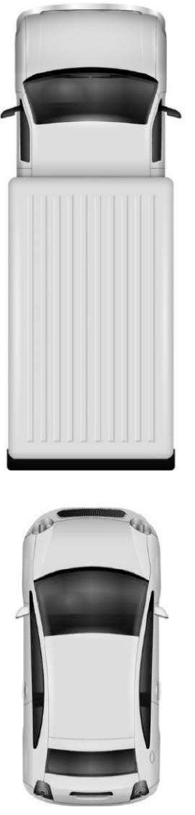
Class B or C Straight Truck/Vehicle Checklist
Driving Kansas Into the Future

Slide 12
Class B or C Straight Truck/Vehicle Guide
Driving Kansas Into the Future

Slide 13
Class B or C Straight Truck/Vehicle Guide
Driving Kansas Into the Future

Slide 14
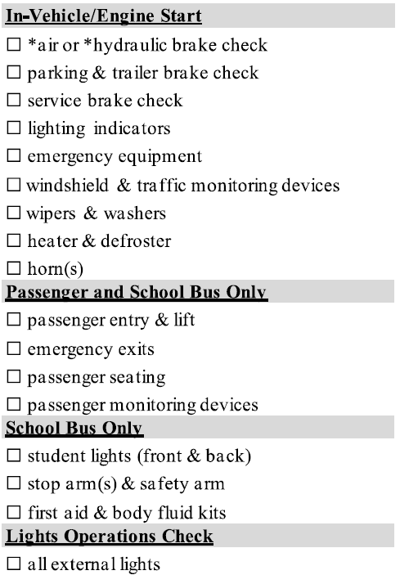
Class B or C Passenger/School Bus Checklist
Driving Kansas Into the Future

Slide 15
Class B or C Passenger/School Bus Guide
Driving Kansas Into the Future

Slide 16
Class B or C Passenger/School Bus Guide
Driving Kansas Into the Future

Slide 17
Class B or C Passenger/School Bus Guide
Driving Kansas Into the Future

Slide 18
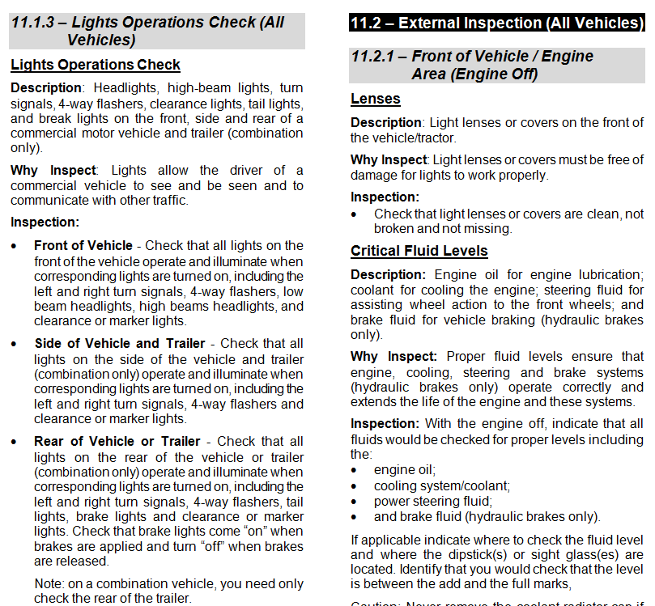
Driver Manual Section 11
Drivers Manual – Section 11
Driving Kansas Into the Future

Slide 19
What’s the Same?
What’s Different?
Vehicle Inspection:
Fewer items (focus on safety critical items).
Driver VI Checklist.
Driver’s Manual now includes “Description” and “Why Inspect” (rationale). Driver’s and Examiner’s Manuals will be in sync on criteria.
Drivers will be required to describe “What” they are inspecting and may include “Why” they are inspecting it.
Four-part Air Brakes check.
Revised coupling system criteria.
Other revised scoring criteria.
Calculate number of items missed.
Driving Kansas Into the Future

Slide 20
What’s the Same?
Overview of Modernized
Basic Skills Testing
Overview of Proposed Modernized
Basic Control Skills Test
Driving Kansas Into the Future

Slide 21
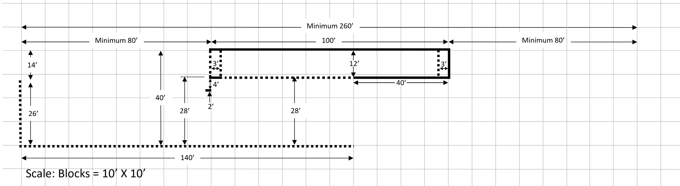
Proposed Basic Control Skills
Proposed Exercise Dimensions
Page 12-5
Driving Kansas Into the Future

Slide 22


Proposed Basic Control Skills
Proposed Modernized
Basic Skills Testing Maneuvers
Forward Stop; Straight Line Backing;
Forward Offset Tracking; Reverse Offset Backing
75’ Class A
40’
Page 12-4
Driving Kansas Into the Future

Slide 23
Comparison – 2005 Model vs. Modernized
Basic Skills Testing Course Footprints
Comparison
Forward Stop Box, Straight Line Backing, Forward Tracking and Off-Set Reverse Tracking – Comparison of current BCS exercises
Parallel Parking
(Conventional & Sight-side)
Offset Backing Left
Straight Line Backing
Offset Backing Right
90° Alley Dock
Driving Kansas Into the Future

Slide 24
Proposed Basic Control Skills
Proposed Modernized
Basic Skills Testing Maneuvers
Forward Stop; Straight Line Backing;
Forward Offset Tracking; Reverse Offset Backing
75’ Class A
40’
Page 12-4
Driving Kansas Into the Future

Slide 25
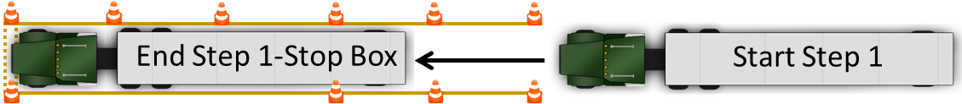
Proposed BCS Maneuvers
Proposed Basic Control Skills
Step 1 – Forward Stop
Step 2 – Straight Line Backing
Page 12-2 thru 12-3
Driving Kansas Into the Future

Slide 26
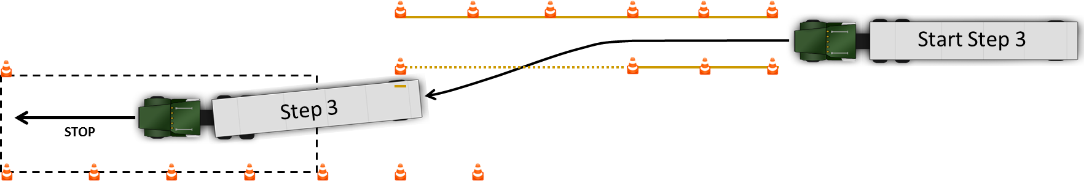
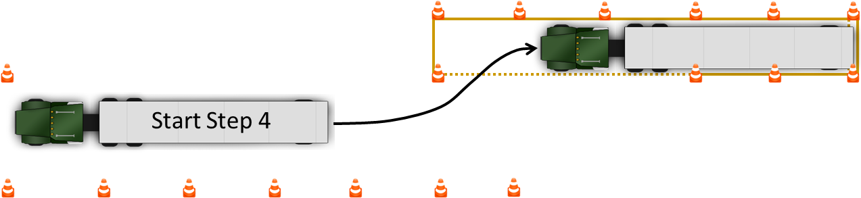
Proposed BCS Maneuvers
Proposed Basic Control Skills
Step 3 – Forward Offset Tracking
Step 4 – Reverse Offset Backing
Page 12-2 thru 12-3
Driving Kansas Into the Future

Slide 27
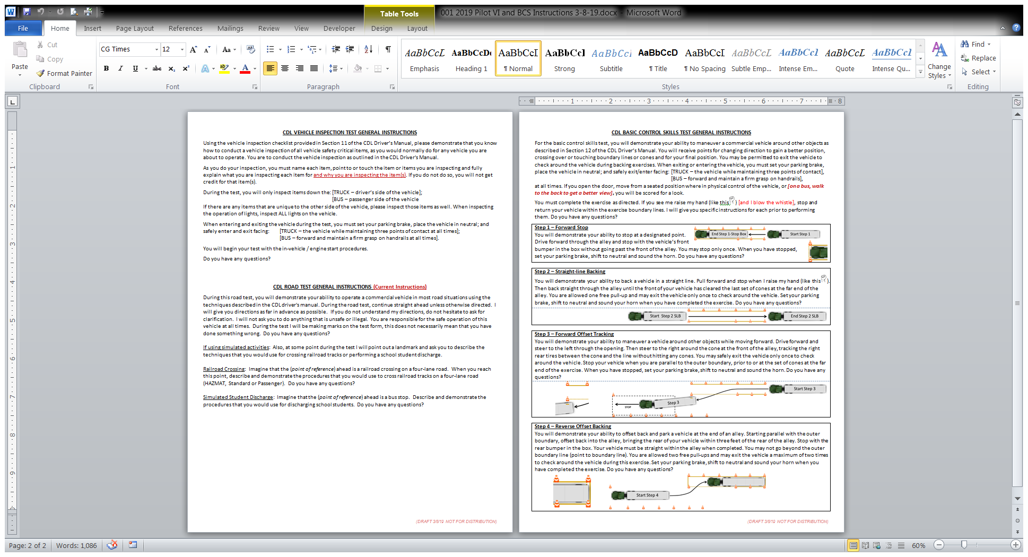
What’s the Same?
Proposed BCS Instructions
Driving Kansas Into the Future

Slide 28
What’s the Same?
BCS Scoring Standards
Clearance – the distance between the cone and the line when performing
Part 3 – Forward Offset Tracking
Back-ups – backing up on a forward moving exercise to clear an encroachment or to get a better position is scored as a “back-up”.
Pull-ups – pulling forward on a backing exercise to clear an encroachment or to get a better position is scored as a “pull-up”. Stopping without changing direction does not count as a pull-up.
Encroachments – crossing over or touching exercise boundary lines or cones with any portion of the vehicle is scored as an encroachment.
Page 12-1
Driving Kansas Into the Future

Slide 29
What’s the Same?
BCS Scoring Standards
Looks – exiting the vehicle to look around during a backing exercise. You may be permitted to safely stop and exit the vehicle to check the external position of the vehicle (look).
You may be allowed a maximum of one (1) look on Part 2 – Straight-line Backing and two (2) looks on Part 4 – Reverse Offset Backing, to check the position of your vehicle.
Page 12-1
Driving Kansas Into the Future

Slide 30
What’s the Same?
BCS Scoring Standards
Final Position – the final position of the vehicle for backing exercises. You will be scored for final vehicle position on Part 2 – Straight-line Backing and on Part 4 – Reverse Offset Backing.
Failure to Follow Instructions or Unsafe Act – Failure to follow examiner instructions for completing the exercise as directed may result in an automatic failure and the test may be terminated by the examiner.
Committing an “unsafe act” (e.g., not entering or exiting the vehicle safety or forgetting to set the parking brake), may result in an automatic failure for an unsafe act and the test may be terminated by the examiner.
Page 12-1
Driving Kansas Into the Future

Slide 31
What’s the Same?
What’s Different?
Basic Control Skills:
Forward Stop Box
Forward Offset Tracking
Scoring “Clearance” on Forward Offset Tracking
Scoring “Back-ups” on forward moving exercises
Reverse Offset Tracking vs. Parallel and Alley Dock
Much smaller footprint
Driving Kansas Into the Future

Slide 32
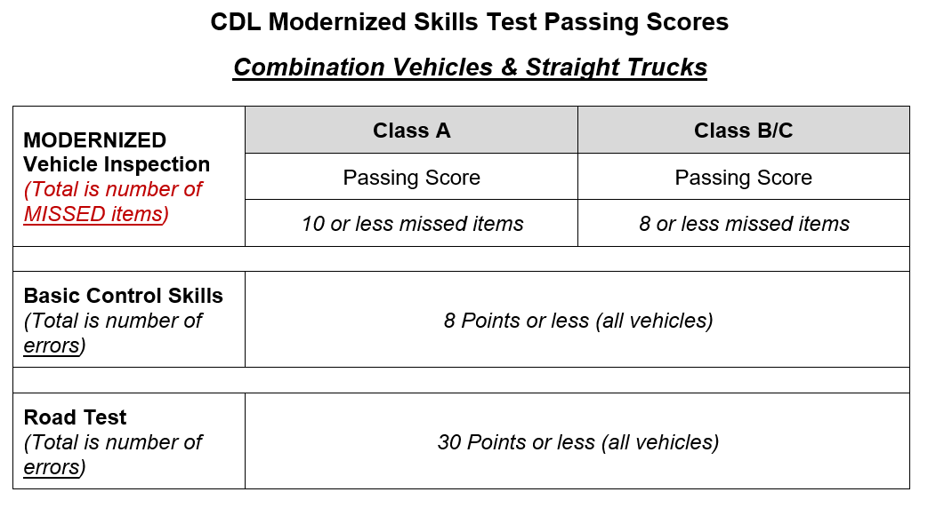
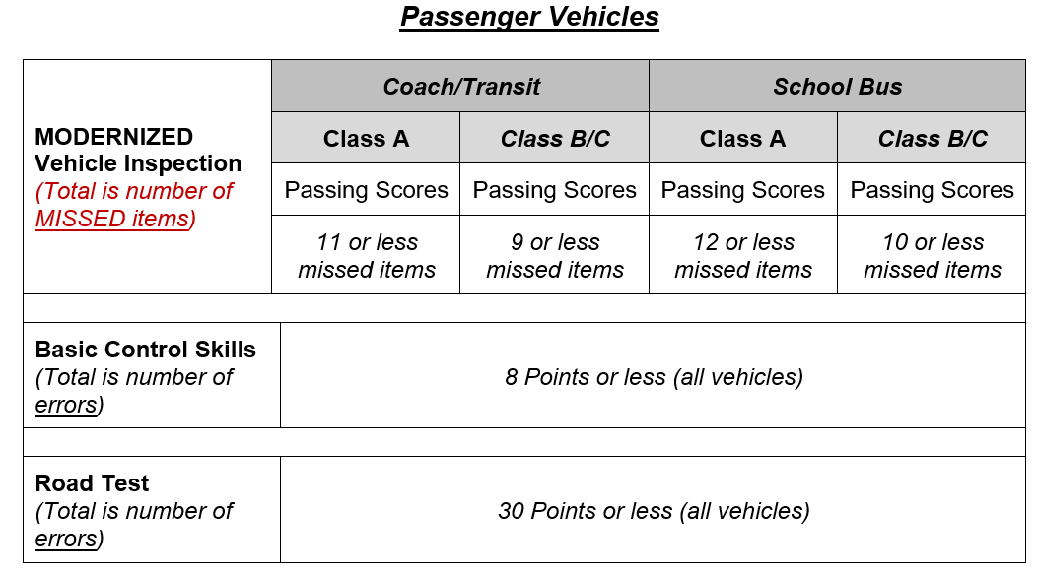
What’s the Same?
Passing Scores
Driving Kansas Into the Future

Slide 33
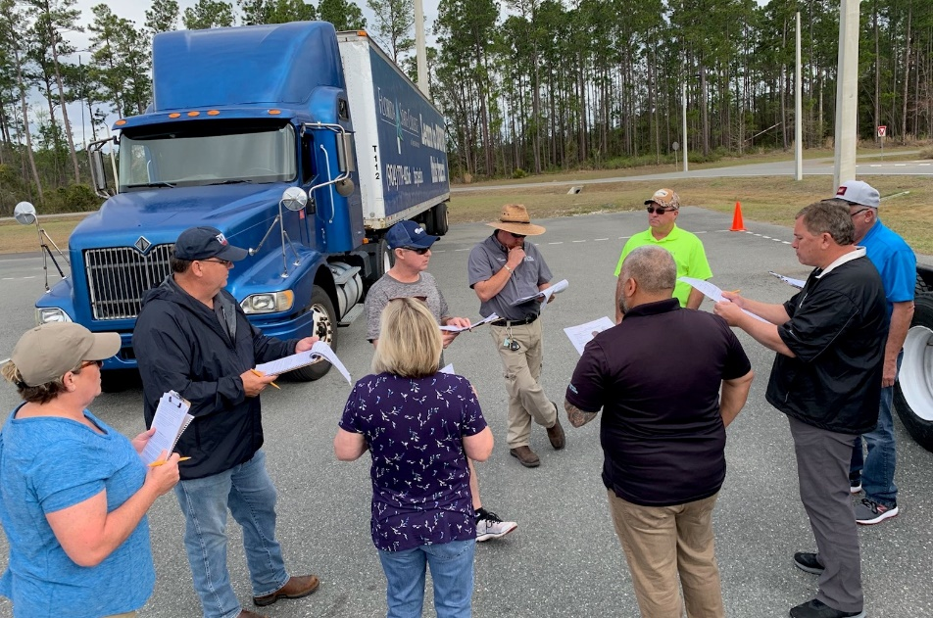
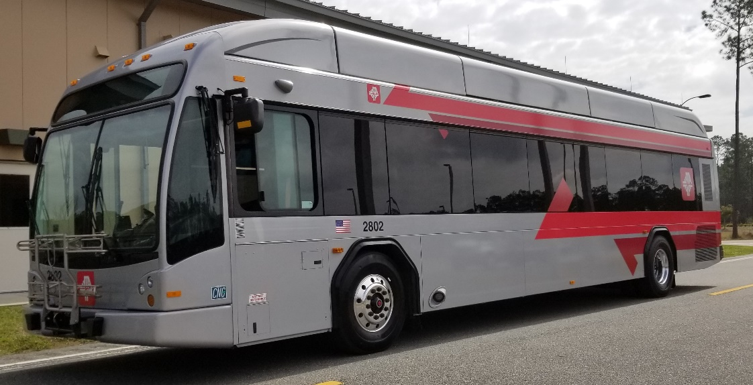
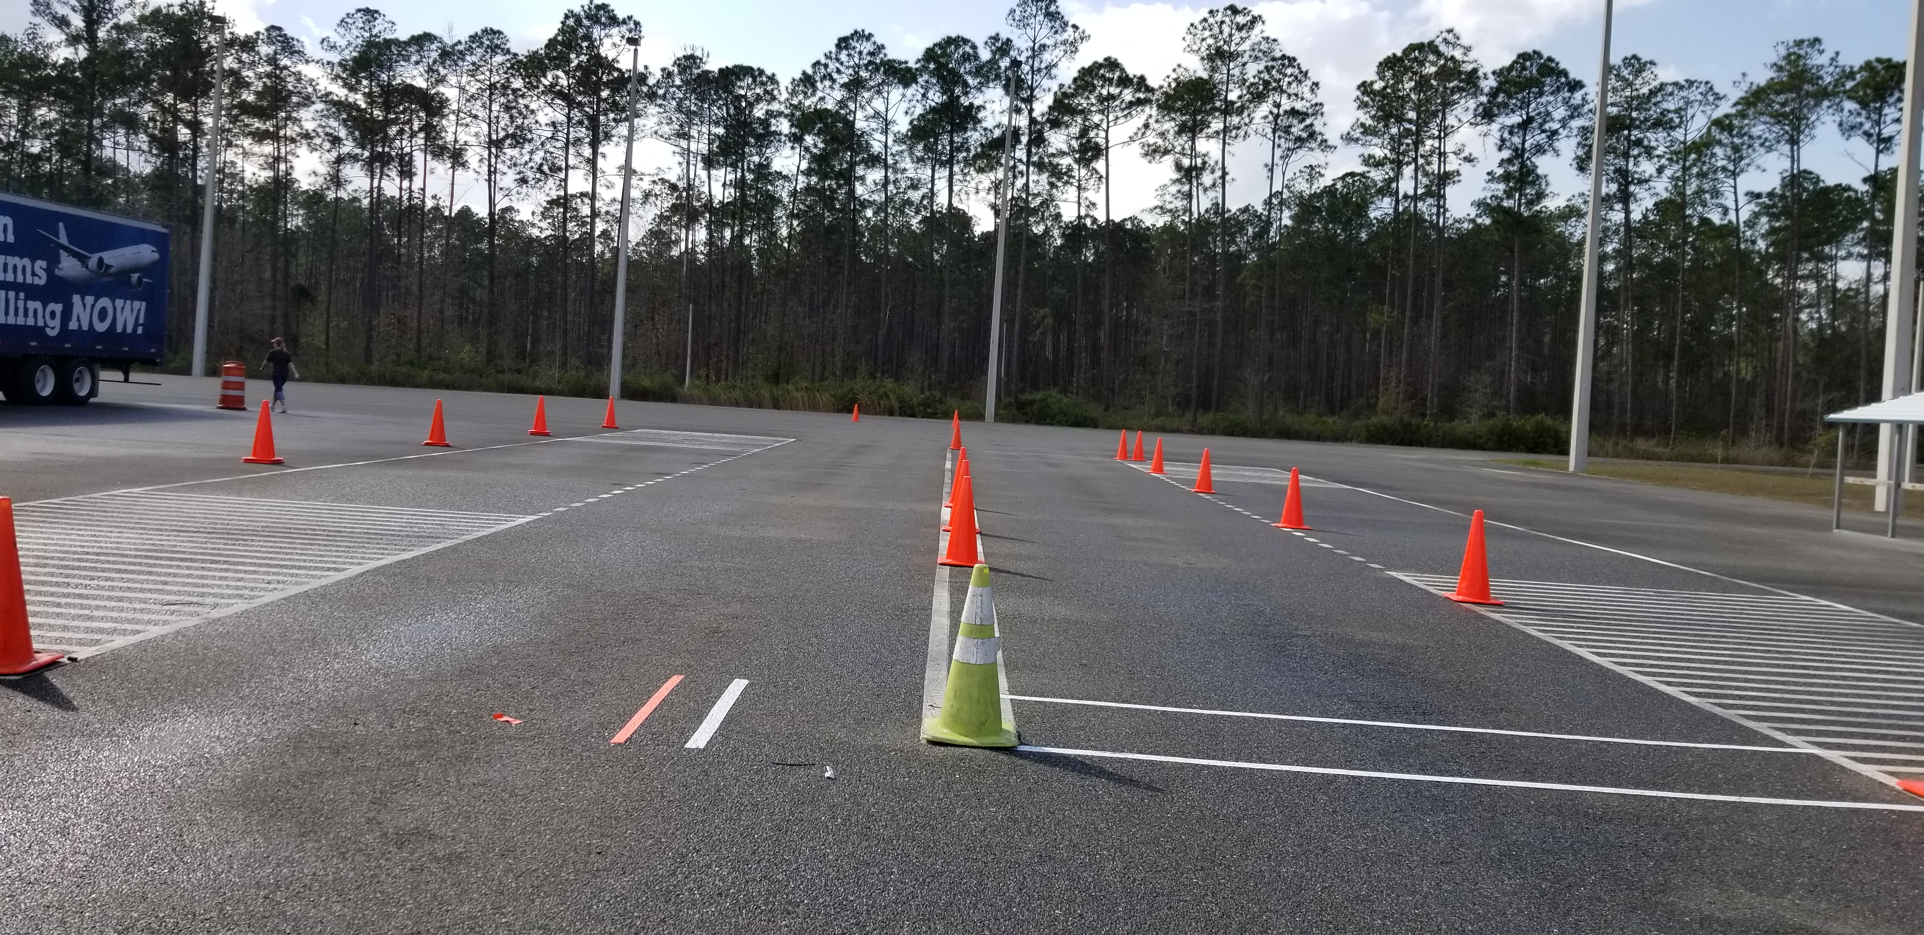
What’s the Same?
And the Fun Begins!!!
Driving Kansas Into the Future

Slide 34
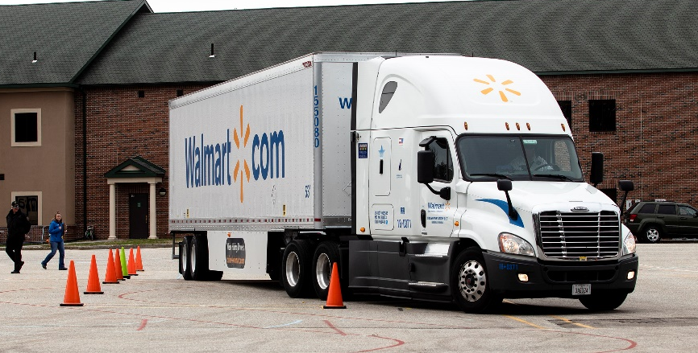
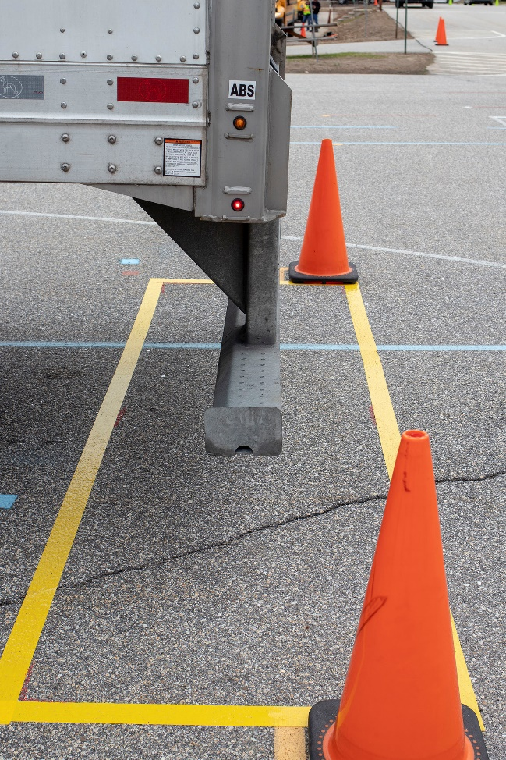
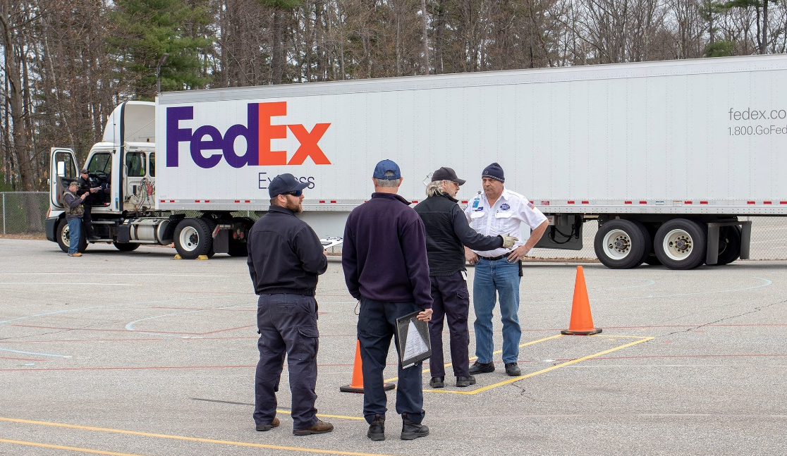
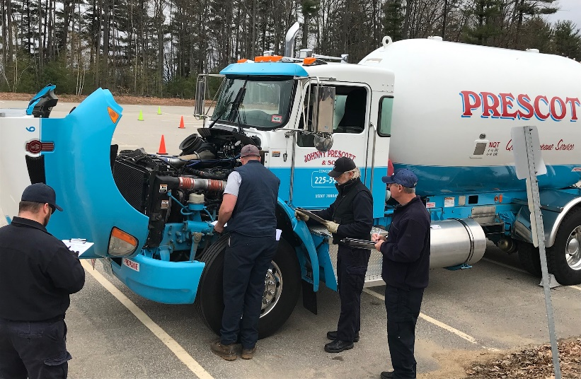
What’s the Same?
Isn’t This Exciting!!!
Driving Kansas Into the Future

Slide 35
What’s the Same?
Contact Information
FOR MORE INFORMATION or ASSISTANCE
CONTACT:
Brian Brunt Don Britain
State CDL Coordinator CDL Program Consultant
785-213-9157 785-506-9907
Brian.Brunt@ks.gov Don.Britain@ks.gov
Driving Kansas Into the Future

